Slide 1

MAULANA AZAD NATIONAL INSTITUTE OF TECHNOLOGY BHOPAL
Training and Placement Portal
Submitted By:
Ayush Kedia 131112005
Ankit Agrawal 131112201
Balram Kirar 131112085 Under The Guidance Of:
Prasanna Venkatesh 131112096 Dr. Meenu Chawla

Slide 2
Abstract
The Proposed Method for developing a management system for the Training and Placement cell will help students to register themselves for the placement drive through electronic means and will enable the members of TNP cell to efficiently manage the gathered data w.r.t the visiting companies

Slide 3
Why this project?
It is basic logic which makes me undertake this project because as final year students who go through this process day in and day out, we are able to find the existing system obsolete and a lot of manual hardwork has to be done on both the sides i.e, the coordinating team as well as the students using it.
The other drawback the current system faces is that the there is no transparent view for the corporates i.e; the corporates coming for recruitment has no clear picture of the placement procedure in our college.
So these shortcomings makes for a compelling argument for us to undertake the current project which could be advantageous to all involved in this process.

Slide 4
Drawbacks Of Current System
No common medium to uniformly inform all students of all branches.
Unfeasible for students to update their record.
Social Medias like Facebook and Whatsapp cannot be the most reliable medium through which such information can be communicated.
No proper medium available to inform students during urgent scenarios.
The management of database is a very tedious process and prone to a lot of errors.

Slide 5
Drawbacks...
Short listing of students according to eligibility criteria is done manually and is not transparent enough.
No medium for the companies to get to know of the placement details of the campus.
Companies don’t have enough information regarding the procedure to apply for the recruitment drive.
Large amount of time spent if any additional information is needed from the students side.

Slide 6
Features
Students:
News Feed
Login
Fills database
Updates database
Gets notification about companies activities
Common medium where student can poll their decisions
Can enquire the details about any placement procedure
Can know about their feedback provided by the company

Slide 7
Features…
TnP Cell:
Manages company database
Manages student database
can share the schedule with students beforehand
sends student database according to the criteria specified by the company
Notify student about the company activities
post about upcoming companies through newsfeed
provides company with student data according to their specified format
Update Placed Student record
Managed database of student based on various parameters.

Slide 8
Features...
Corporates:
Can know about placement procedure through a common medium.
Can know about college placement details.
Can request for placement drive.
Feedback after the recruitment which will be shared with all students.
Can view the contacts of all the TnP committee members.
They can view the institute brochure.

Slide 9
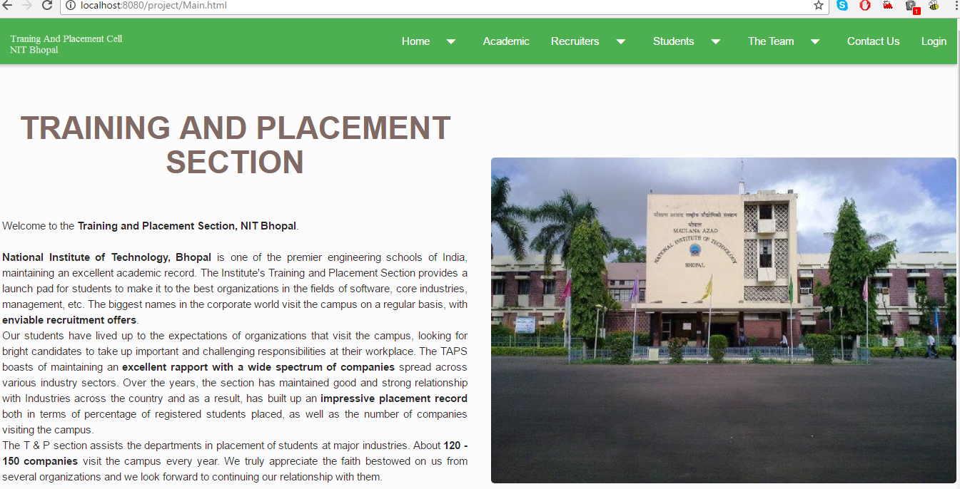
Screen Shot

Slide 10
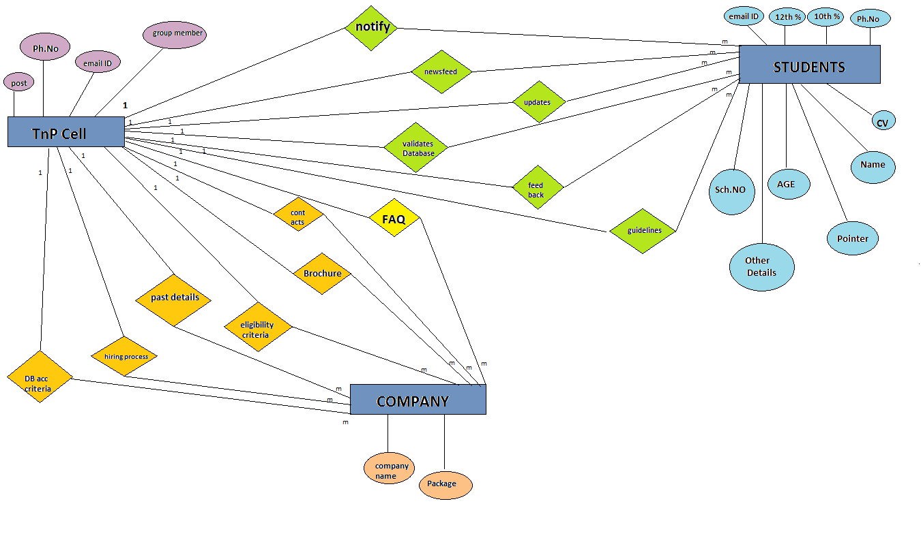
Entity Relation Diagram

Slide 11
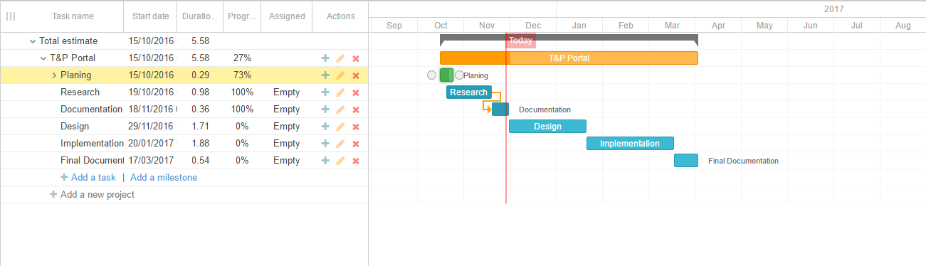
Gantt Chart

Slide 12
Stakeholders/Users
Stakeholders:
Training And Placement Student Welfare Cell.
Users:
Students
TnP Committee
Corporates

Slide 13
Technologies Used
Front End:
Java Script
JQuery
HTML
CSS
Back End:
Java
MySql
PHP

Slide 14
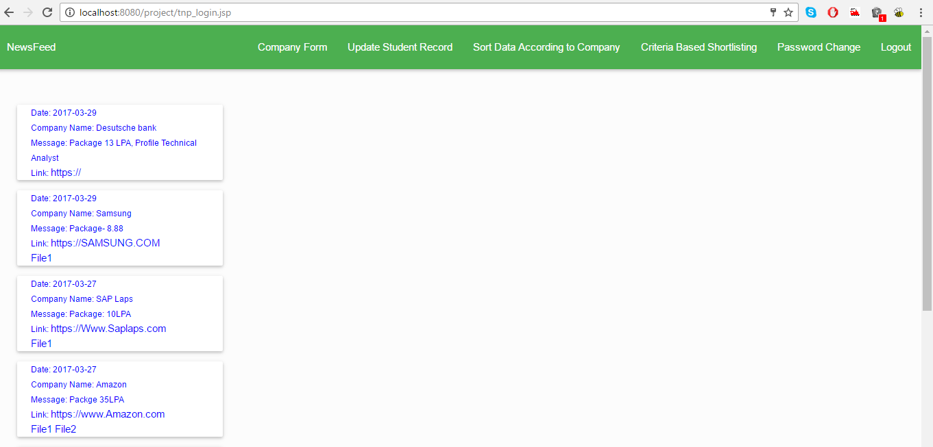
Screen Shot

Slide 15
Future Scope…
This Project can be accompanied by a mobile application from where students can login to their account, Get notification on their mobile phone about any kind of event related to placement such as Written test timing, Interview Timing, Pre-Placement Talk timing, etc.
These events can further be combined with Google calendar which can automatically set remainder specific to each student and remind them before the scheduled event.
Database associated with this web portal can be used by the proposed mobile application to load the newsfeed and store students record properly

Slide 16
Conclusion…
From proper analysis of positive constraints on the component, it can be safely concluded that the product is a highly efficient GUI based component. This component can be easily plugged in many other systems. Also the component is user friendly. Generally the TPO's of the Colleges has to face a lot of problems in management of the Students information. This all information has to be managed manually. So, there is need to develop a system that solves the mentioned problem. This software comes with just that solution.

Slide 17
References…
Training And Placement Cell.
Tutorials Point for basic idea about software development life cycle.
Wikipedia for details about Gantt chart.
YouTube to understand working of Gantt chart.
Various coding sites to learn languages that will be used for implementation such as W3schools, StackOverflow, tutorialspoint,etc.

Slide 18
Thank You

